Slide 1
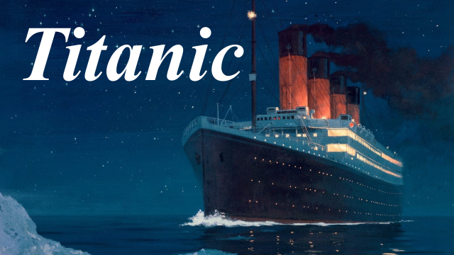

Slide 2
The Titanic was the biggest ship in 1912. The captain, Edward Smith, and the engineers who had designed the Titanic were sure that she was absolutely safe and unsinkable.

Slide 3
A lot of people bought tickets for the first voyage across the Atlantic from Europe to America. There were rich people as well as third class passengers, most of whom were immigrating to America.

Slide 4
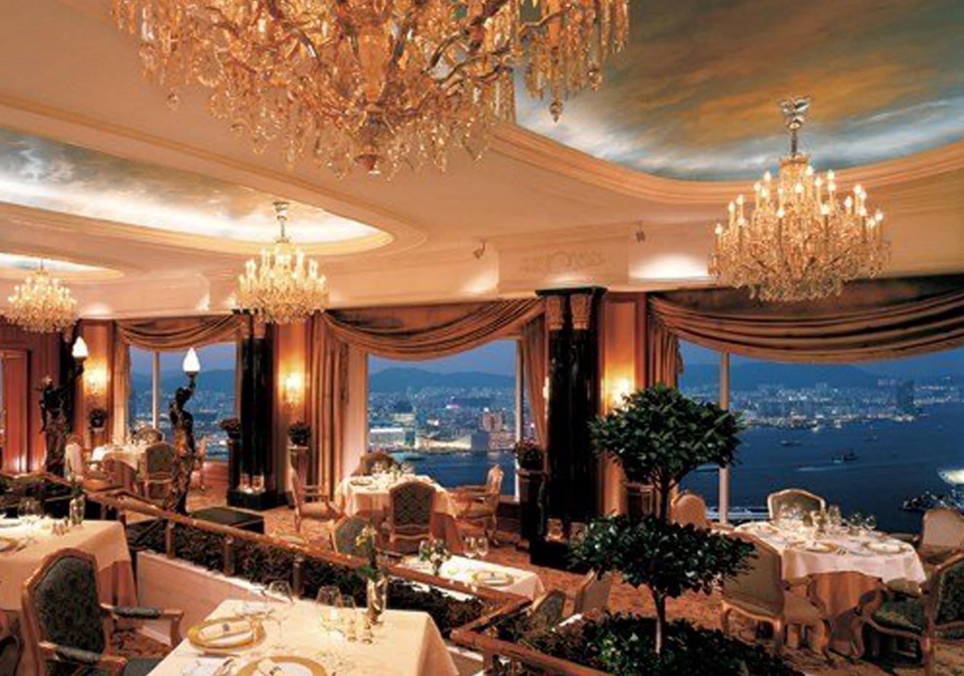
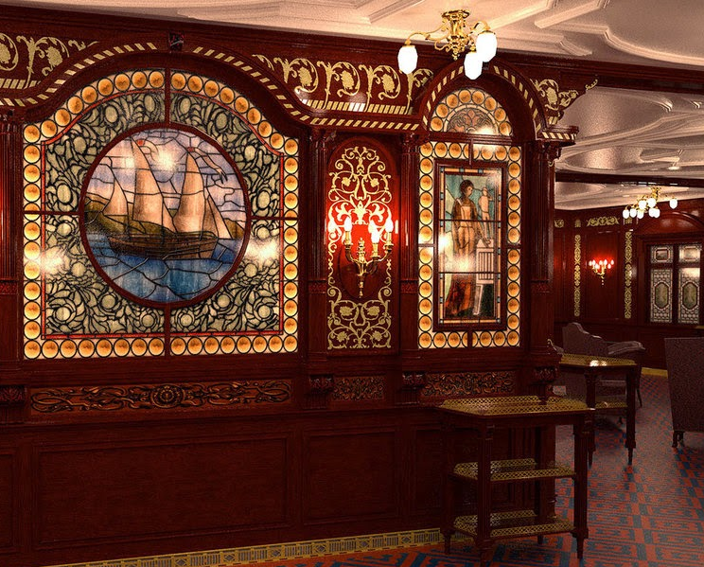
The ship was fantastic. First class passengers could have everything they wanted: lovely music, delicious food, lots of entertainment. They felt relaxed and happy.

Slide 5
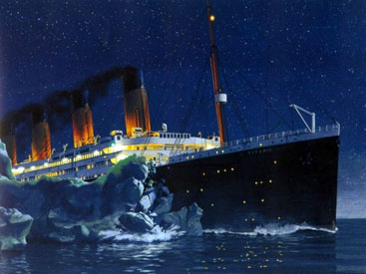
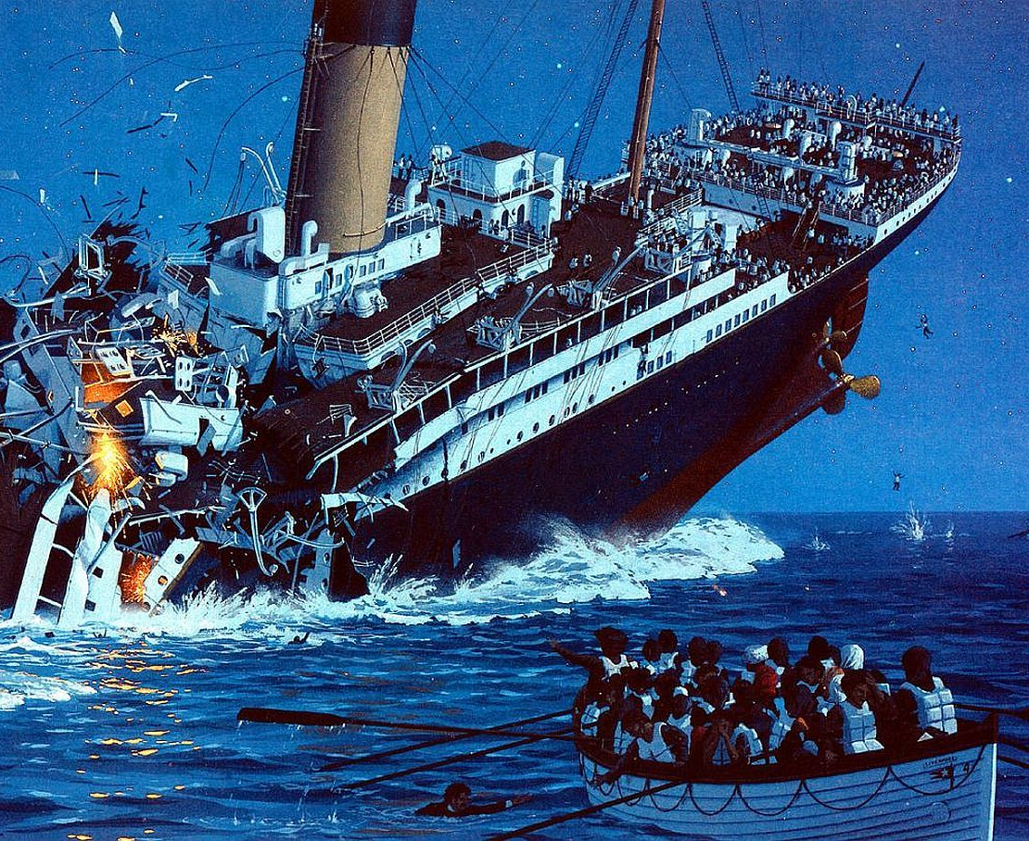
At 11.40 p. m on the 14th of April, everybody on board heard a terrible sound. The Titanic had crashed into an iceberg. Sailors had not noticed it in the dark, misty, cold night. The panic began. It was discovered that there were not enough lifeboats for all the passengers.

Slide 6
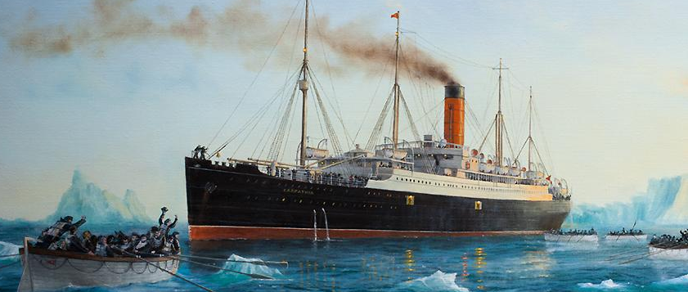
The panic began. It was discovered that there were not enough lifeboats for all the passengers. The liner Carpathia arrived at the site of the tragedy at 5 a.m. on the same day and rescued the people in the lifeboats.

Slide 7
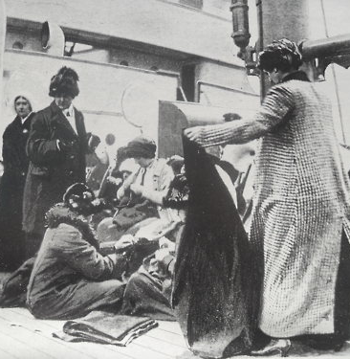
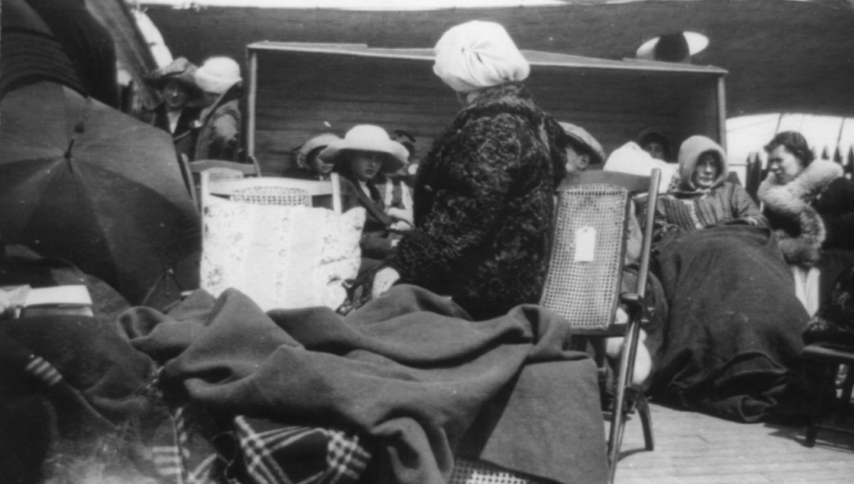
The Carpathia picked up the survivors from the lifeboats. The Titanic sank and took more than 1500 lives with her, only 705 survived.
Group of rescued on Carpathia

